Slide 1
START WITH WHY!
There are leaders and there are those who lead. Start With Why is about a naturally occurring pattern, a way of thinking, acting and communicating that gives some leaders the ability to inspire those around them. The more organisations and people who learn to also start with WHY, the more people there will be who wake up feeling fulfilled by the work they do.

Slide 2
Why Manipulation is not the same as inspiration.
. Simon believes that true leadership means having the ability to inspire people, to provide them with a purpose outside of any benefits or incentives. That these people have the ability to lead because they truly inspire their followers. There is no manipulation or coercion, followers are inspired and feel fulfilled by the work that they do
The aim should be to inspire loyal customers. Loyal customers results in returning business. A loyal customer is so inspired by your brand that they are willing to turn down a better price or product to continue doing business with you.
The short term gains of manipulation may seem like the easy option, but it isn’t sustainable. Inspiring loyal customers means putting in the hard work, but gaining long-term benefits.

Slide 3
The Golden Circle
The Golden Circle is a concept described by Simon, it shows how certain leaders have the ability to inspire action rather than simply manipulating people to act.
Every company in the world knows WHAT they do -e.g. they can describe and define their product or service. Some companies know HOW they do what they do -e.g. they know that their unique selling point is the reason they stand out. Very few companies know WHY they do what they do (and it's not to make money, this is a result). Why do you get out of bed in the morning, what is the companies purpose, and why should anyone care?
Simon uses Apple as the example of an inspirational company. The format a normal company would use to communicate their product goes like this; ‘this is what we do, and this is how we do it.’

Slide 4
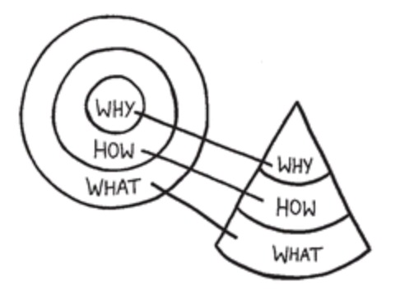
The Golden Circle
WHY – In everything that we do, we believe in challenging the status quo and thinking differently. (This part engages the consumer on an emotional level.)
HOW – The way we do this is to design products that are beautifully designed and easy to use. (The how and the what serve as evidence of the why.)
WHAT – We just so happen to make great computers. Wanna buy one?

Slide 5
THE BIG WHY.
”The WHY does not come from looking ahead at what you want to achieve and figuring out an appropriate strategy to get there. It is not born out of any market research. The Why does not come from extensive interviews with customers or even employees. It comes from looking in the completely opposite direction from where you are now. Finding WHY is a process of discovery, not invention.”

Slide 6
EXAMPLES
People like Martin Luther King Jr…Steve jobs, southwest airlines, Harley Davidson and the Wright brothers had little in common but they all started with WHY. They realized that people would not truly buy into a product, service, movement or idea until they understand the WHY behind it.
Starting with WHY gives your followers and customers a way to identify with you on a personal level; If your WHY matches their WHY, they are willing to stand with you through thick and thin.

Slide 7
CONCLUSION
“People don’t buy WHAT you do; they buy WHY you do it.”
“Leadership requires two things: a vision of the world that does not yet exist and the ability to communicate it.”

